Slide 1
Manufacturing Technology (ME461) Date: 16/01/2018
Instructor: Shantanu Bhattacharya

Slide 2
Review of Previous Lecture
Limitations of a wireframe model.
Non-parametric representation of equation (Implicit case).
Parametric equation based representation of an ellipse.
Parametric representation of synthetic curves.
Concepts of continuity.
Hermite cubic spline fit.

Slide 3
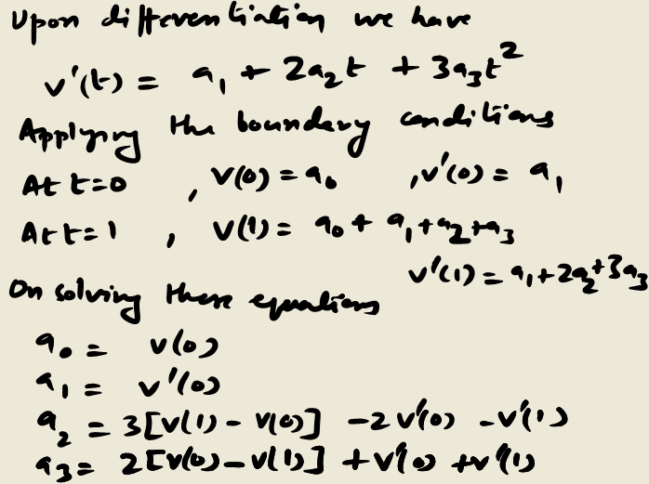
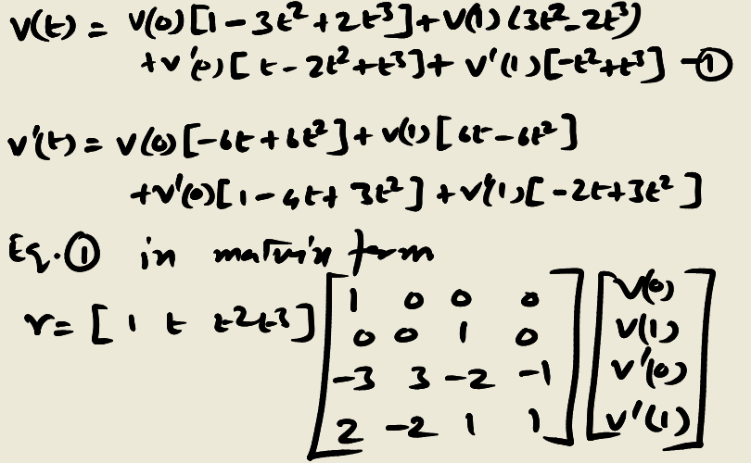
Derivation of the parameter equation
This form can be adjusted to yield various shapes of curve segment by altering one or more of V(0), V(1), V’(0) and V’(1) appropriately.
The Hermite form of a cubic spline is determined by defining positions and tangent vectors at the data points.
There are some disadvantages of this method. For example,
First order derivatives are needed; it is not convenient for a designer to provide first order derivative.
The order of the curve is constant regardless of the no,. of data points.

Slide 4
Example Problem
Determine and plot the equation of Hermite form of a cubic spline form given position vectors and slopes at the data points with vector magnitude equal to 1.
Point 1: A= [1,2]^{T}, slope A= 60 deg.
Point 2: B= [3,1]^{T}, slope B = 30 deg.

Slide 5
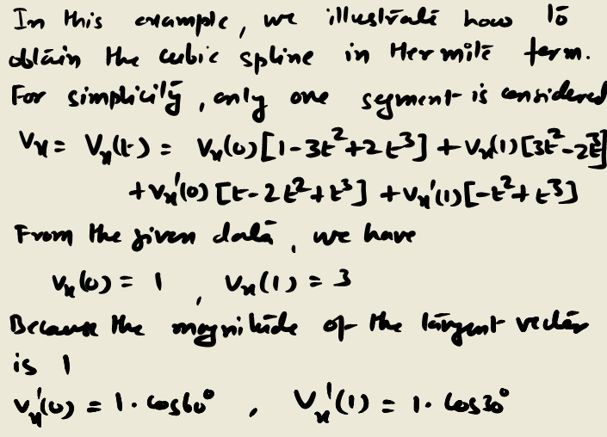
Solution

Slide 6
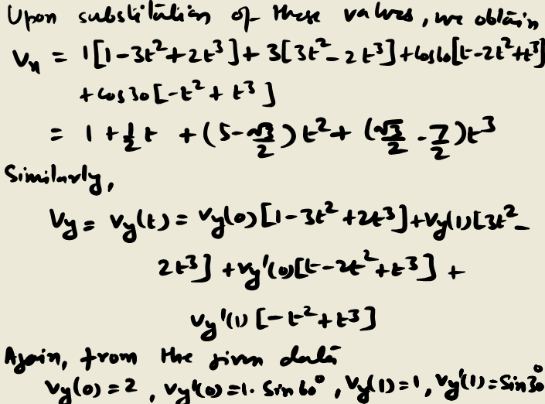
Solution

Slide 7
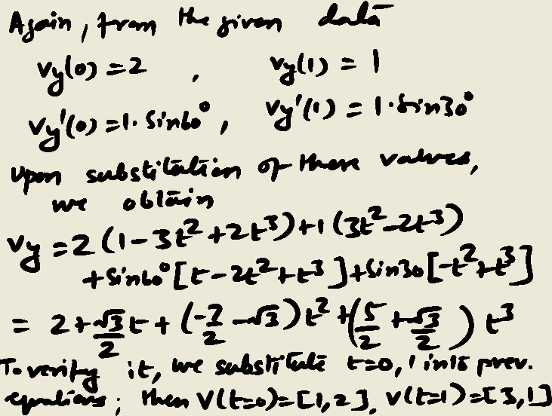
Solution

Slide 8
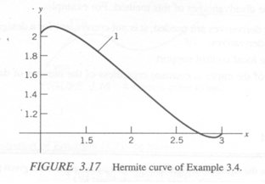
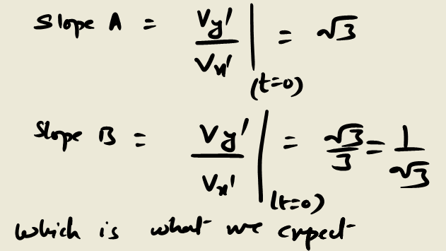
Solution
1

Slide 9
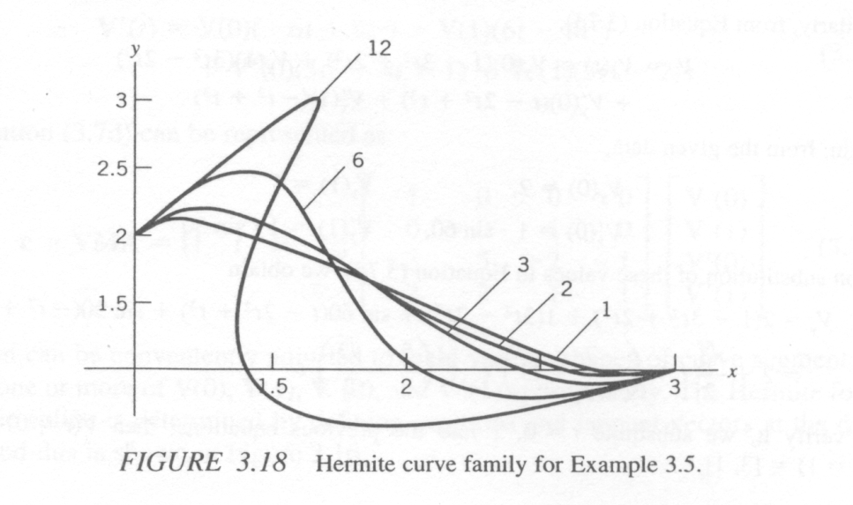
Example problem
On changing the tangent vector of the curve, the shape of the curve changes accordingly. Using the data given in the last problem, a plot can be made given that the magnitude of the tangent vector equals 1,2,3,6 and 12 respectively.
Following the procedure of the earlier example we can find the Hermite curve family equations with different magnitude of tangent vectors. The plots are following:

Slide 10
Bezier Curves
The Hermite curve discussed in the previous section is based on interpolation techniques.
On the contrary, Bezier curves are based on approximation techniques that produce curves which do not pass through all the given data points except the first and the last control point.
A Bezier curve does not require first order derivative; the shape of the curve is controlled by control points.

